Slide 1

Introduction to gravitational-wave population inference
Aditya Vijaykumar
Scientific Machine Learning for Gravitational Wave Astronomy 5th June 2025

Slide 2
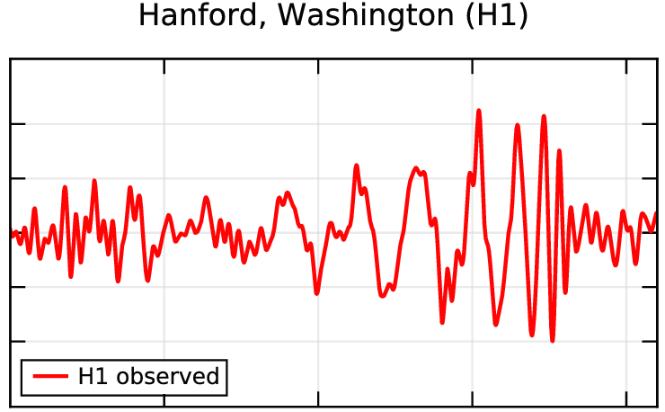
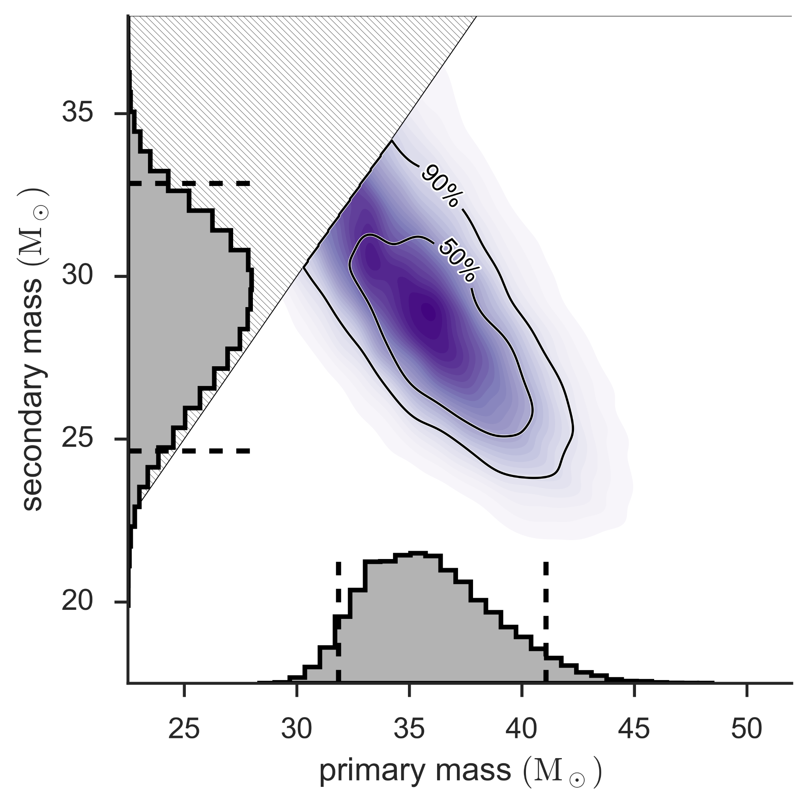
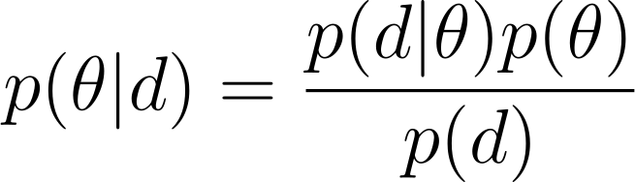
Recap
Measurement of Parameters (Posterior Distribution)
Time Series
GW150914
Abbott+ 2016, arXiv:1602.03837, arXiv:1602.03840

Slide 3
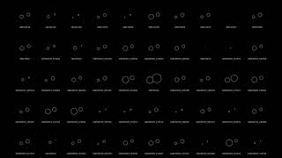
Recap
Credit: Zoheyr Doctor and LVK Collaboration

Slide 4
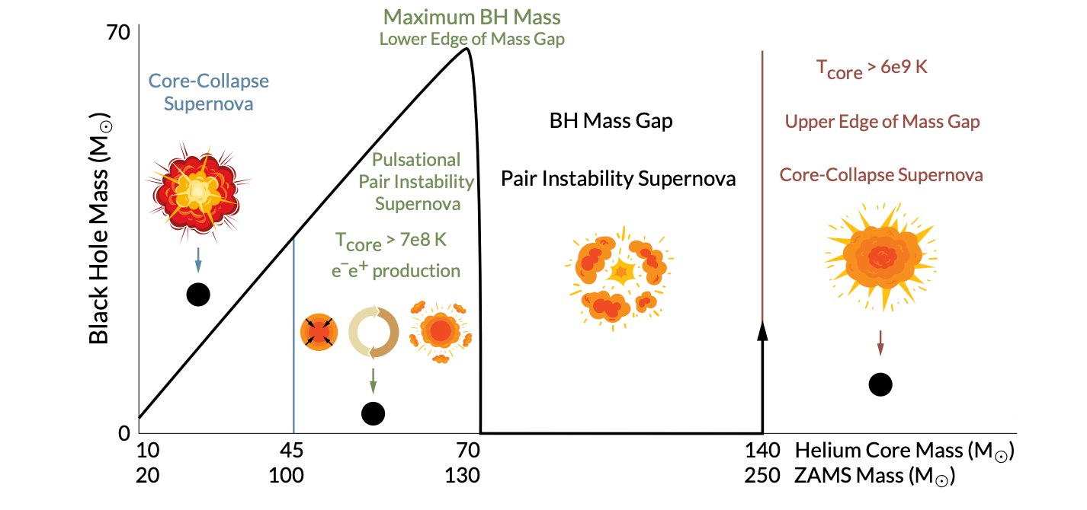
Population-level properties encode astrophysics
Farag+ 2022

Slide 5
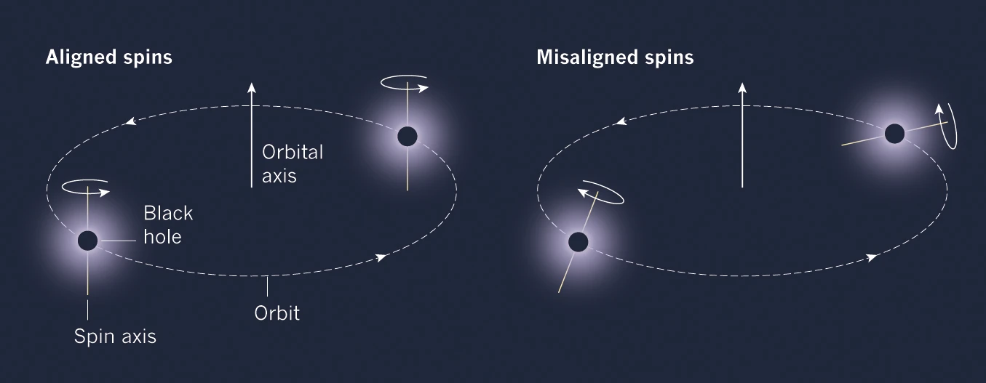
Population-level properties encode astrophysics
Isolated Formation
Dynamical Formation
https://www.nature.com/articles/548397a/figures/1

Slide 6
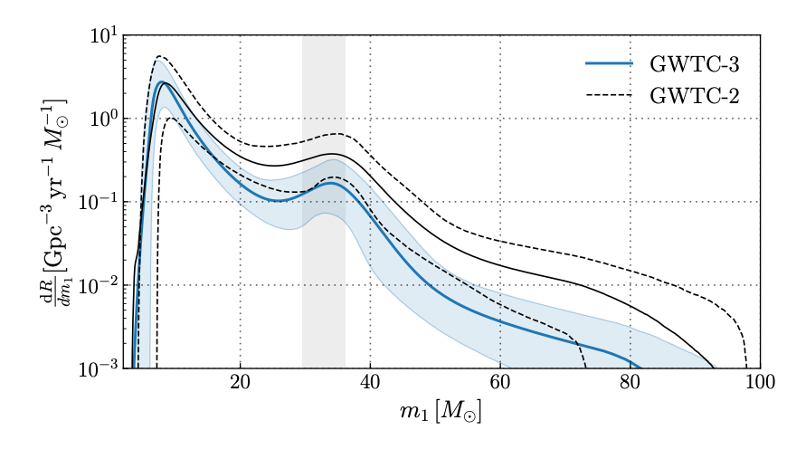
Today’s morning sessions
Measurements of population properties [LVK+, arXiv:2111.0363]
Many uncertain measurements from different sources

Slide 7
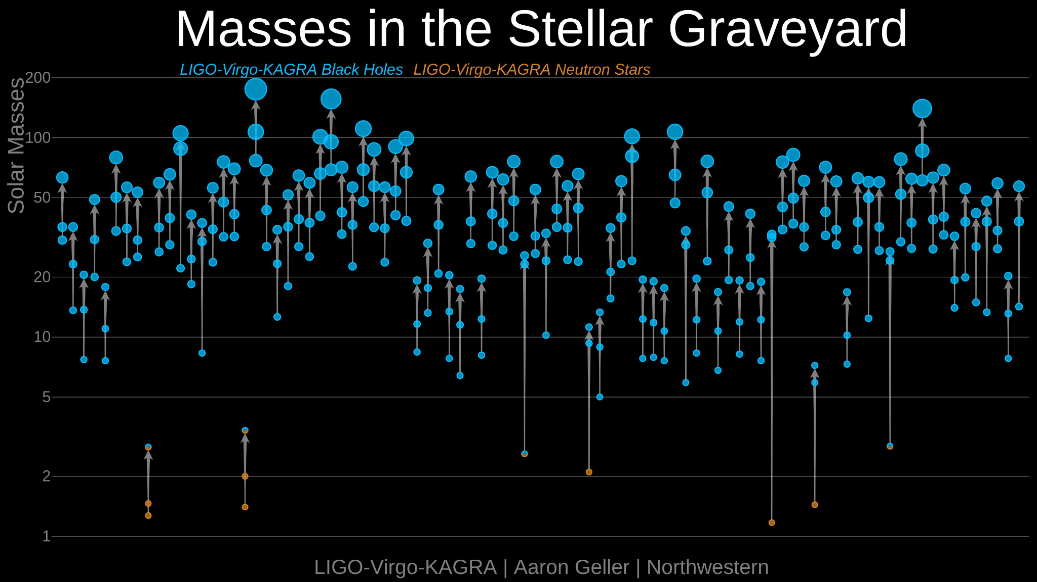
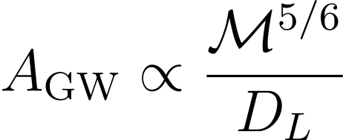
The GW population is obscured by selection effects
Inherently easier to detect massive binaries, and binaries that are close by. …but we can correct for this!

Slide 8
Ingredients
Population parameters, could be:
Slope of the mass distribution
Minimum and maximum masses
Location of e.g. “peaks” in the mass distribution
Mean and variance of spin magnitudes
…etc.
Population Likelihood
Prior

Slide 9
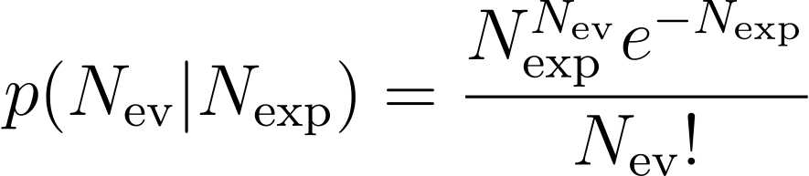
Population Likelihood
The arrival of GWs at our detectors is a Poisson process, so we might think N_{ev} is the number of events observed, and N_{exp} is the number of events expected given a population model parameterized by Λ.

Slide 10
Population Likelihood
The arrival of GWs at our detectors is a Poisson process, so we might think N_{ev} is the number of events observed, and N_{exp} is the number of events expected given a population model parameterized by Λ.
…But it is not a homogeneous Poisson process: N_{exp} depends on the population model and the detector sensitivity to each member of the population
e.g. some population model might predict 5 Msun and 50 Msun BHs at the same rate, but selection effects mean we’ll detect more 50 Msun BHs.

Slide 11
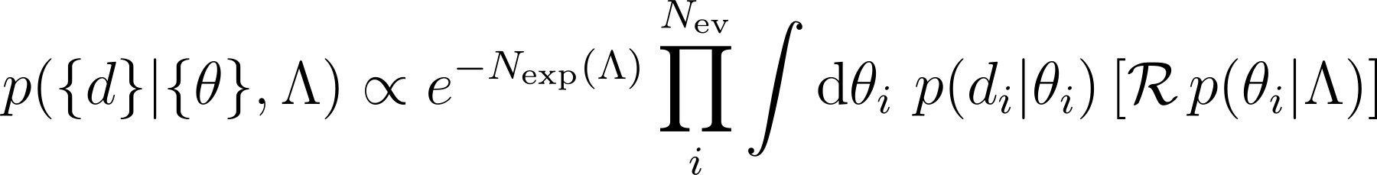
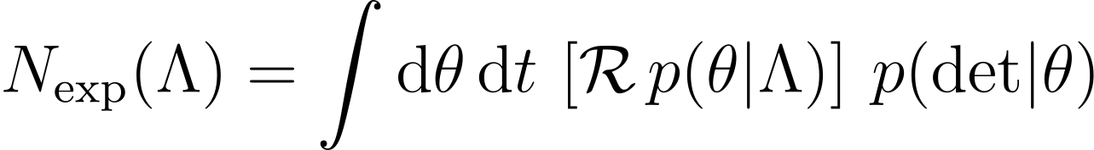
Population Likelihood
Assuming a inhomogeneous Poisson process, the population likelihood can be written as
Intrinsic rate
For a full derivation, see Vitale et al 2020
Single-event PE likelihood
Population model
Probability of detecting a signal with parameters θ. Is either 1 or 0.

Slide 12
Approximating the population likelihood
Both these expressions involve integrals in high dimensions. Solution: Convert integrals into Monte Carlo sums.

Slide 13
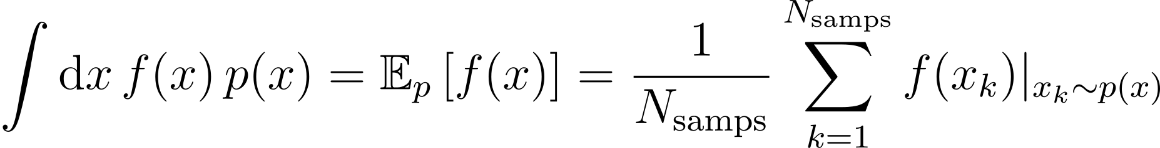
Approximating the population likelihood
Integrals like these are expectation values of a function f(x) under some probability distribution p(x). Can be approximated by drawing samples from p(x), and calculating an average of the f(x) over those samples

Slide 14
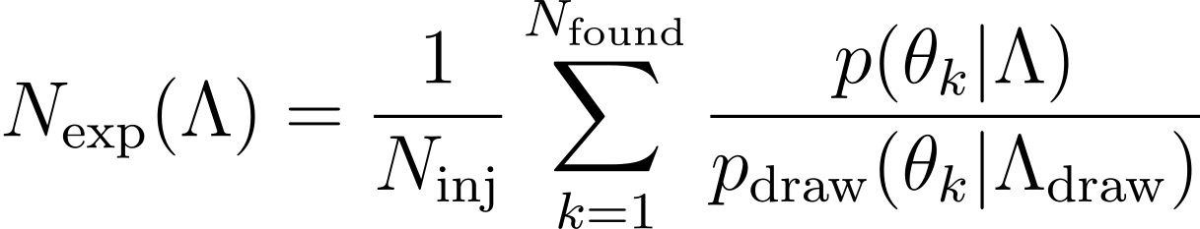
Approximating the population likelihood
Choose a fiducial draw population distribution → simulate and inject event parameters → check if they are detected.
Approximate N_{exp} as a sum over “found” injections.

Slide 15
Approximating the population likelihood
Similarly, the integral over individual event likelihoods can be approximated using single event posterior samples.

Slide 16
Approximating the population likelihood
We now have everything to calculate the likelihood!
Approximate using simulated “injections”
Approximate using single-event PE samples
However, Monte Carlo sums have uncertainties, which become important especially when the population model has sharp features [Essick and Farr 2022, Talbot and Golomb 2023]. Typical strategy: set likelihood to 0 when variance in the Monte Carlo Estimator is above a threshold.

Slide 17
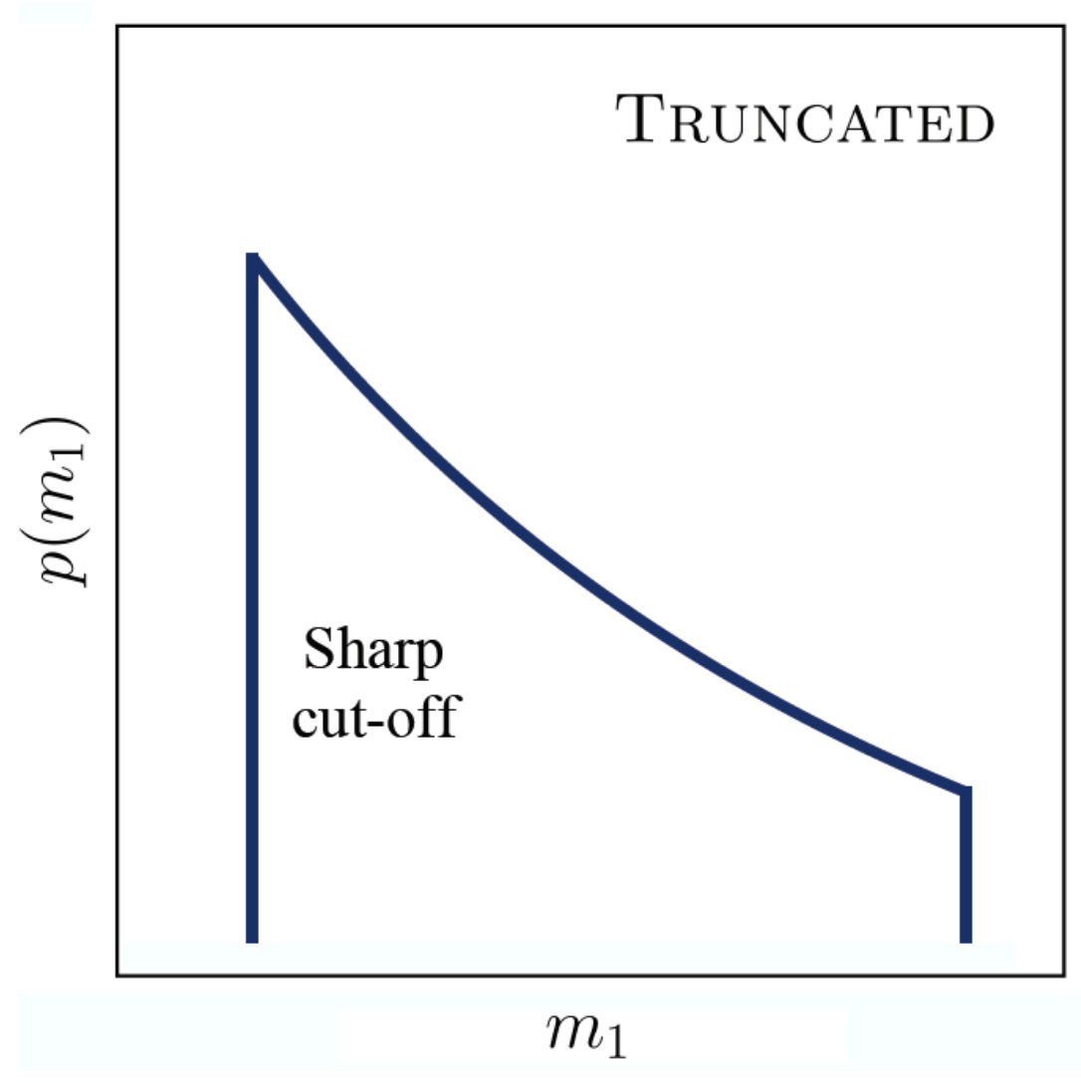

Example: Power law slope and maximum mass
The mass function of stars is a power law with exponent 2.3 with a M_{max}~300 Msun
What are the corresponding numbers for black holes?
Abbott et al 2020 (GWTC-2 Population paper)
α
M_{max}

Slide 18
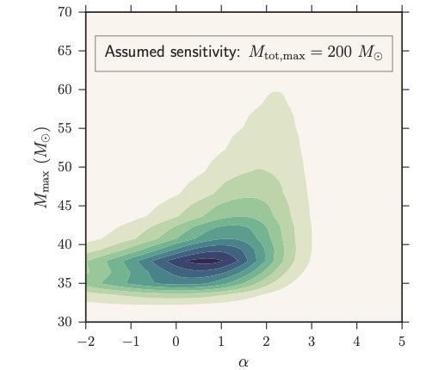
Example: Power law slope and maximum mass
Λ = {α, M_{max}}
Fishbach and Holz 2017
Used only the first 6 reported GW detections

Slide 19
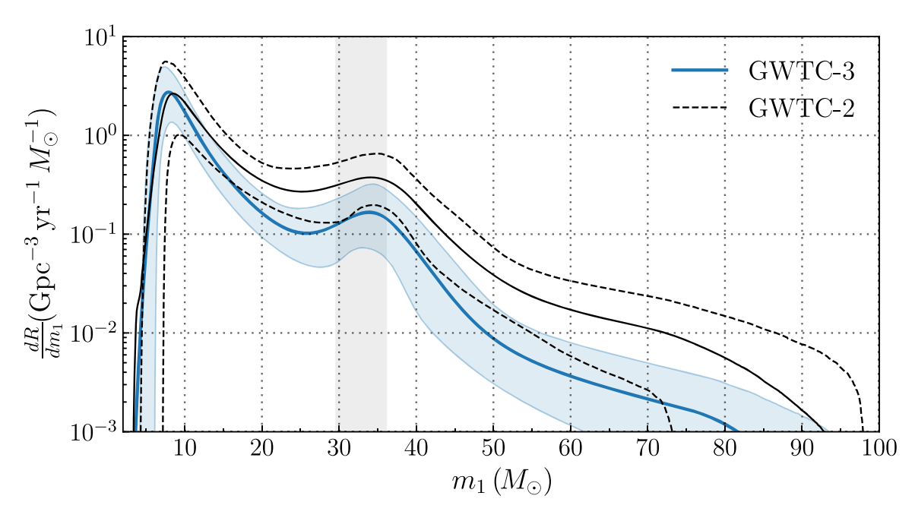
Example: Power law slope and maximum mass
With more data, we now know that a simple power law is not a good fit to the data.
(Power law + Peak model)
Abbott et al 2021 (GWTC-3 Population paper)

Slide 20
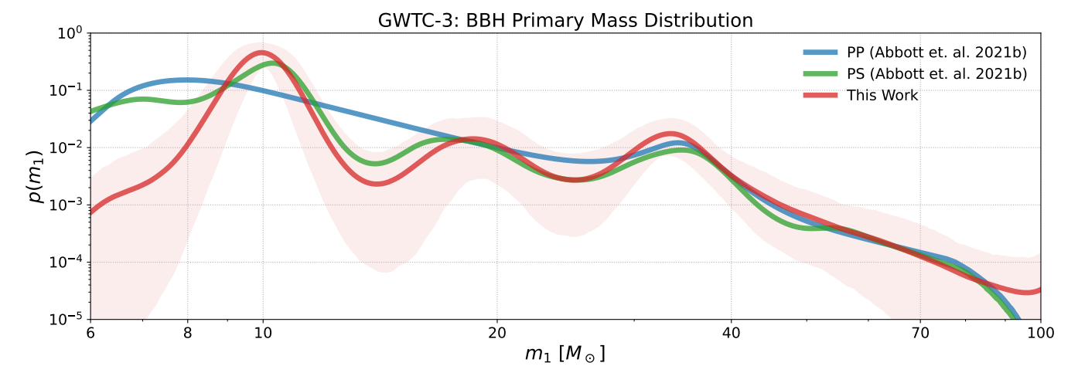
Example: Power law slope and maximum mass
Edelman et al 2023
Abundance of structure in the BH mass distribution → “non-parametric” approaches

Slide 21
Summary
Thinking beyond single-event parameters and viewing events as a population can help us constrain astrophysical properties.
Need to correct for selection effects in order to estimate population properties.
Population likelihood is approximated using Monte Carlo sums.
Choice of population model can induce modeling systematics, might need flexible approaches.

Slide 22
Thanks for Listening!
Get in Touch!
Website: adivijaykumar.github.io
Email: aditya@utoronto.ca

